Slide 1
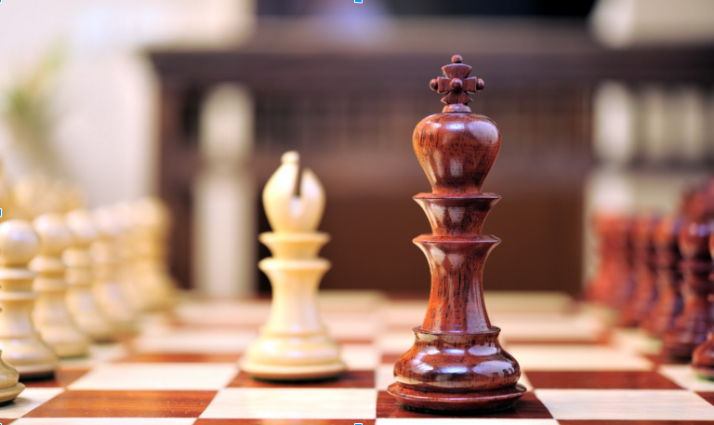
Chess Board with MiniMax AI
By Andrew Callahan, MacKenzie Cavanagh, Christopher Clarizo, and Kyle Miller

Slide 2
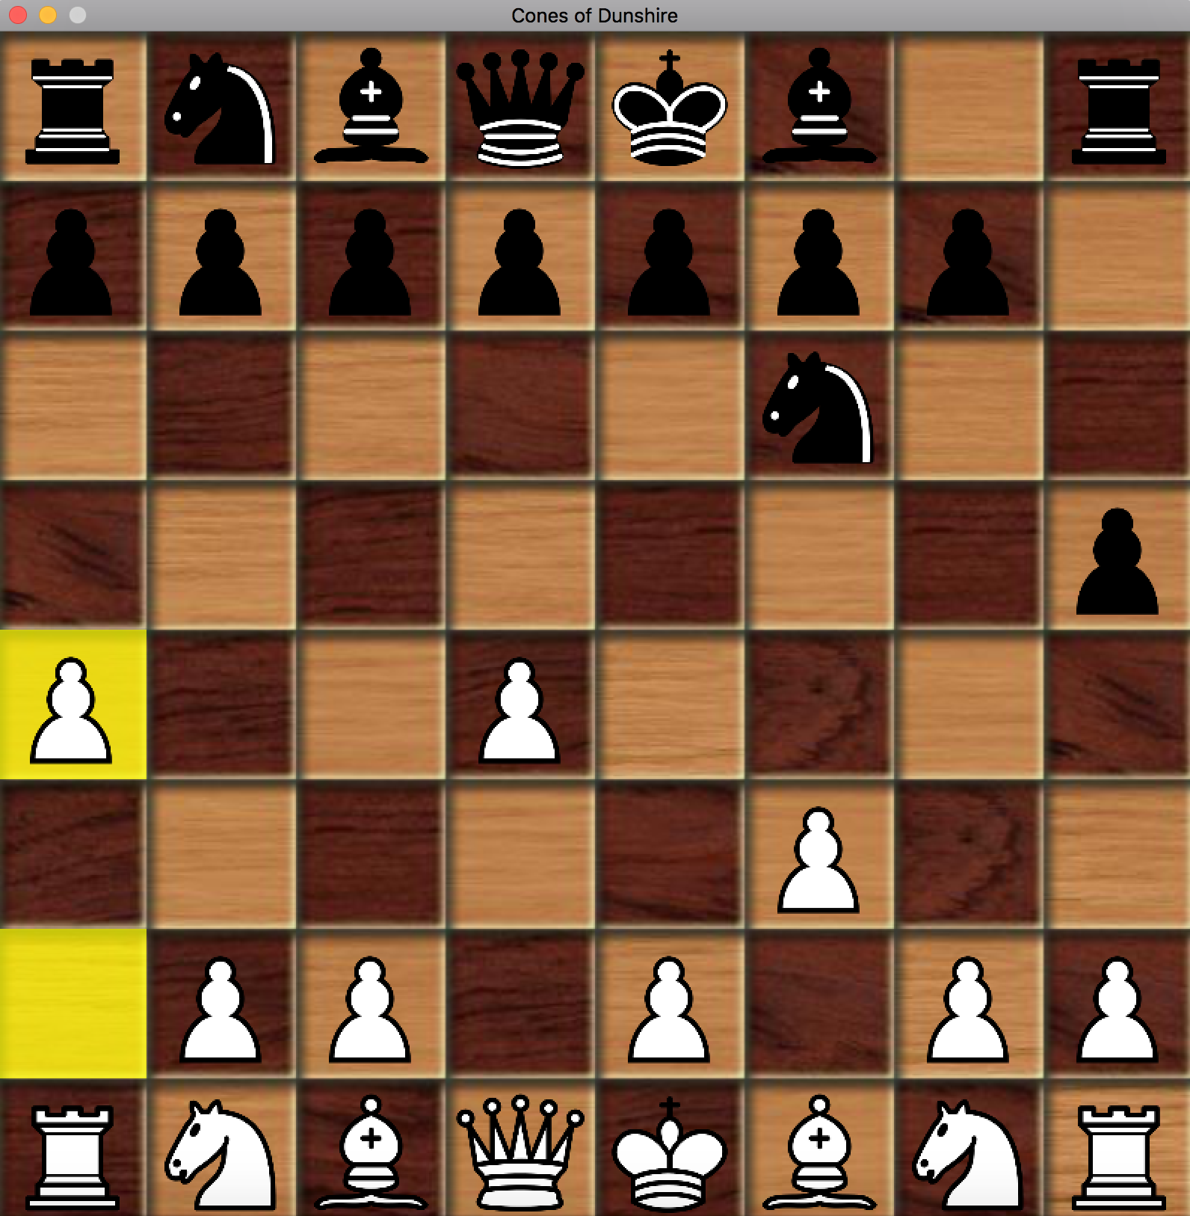
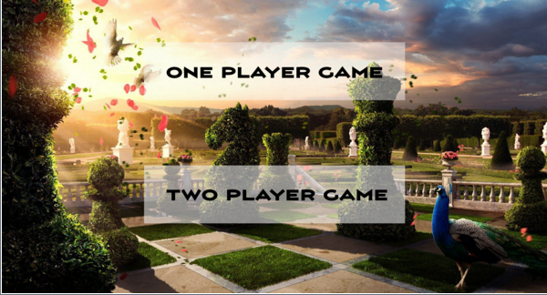
What we did and how it was fun
Chess!
Two player option vs Computer play option
AI and graphics implementations

Slide 3
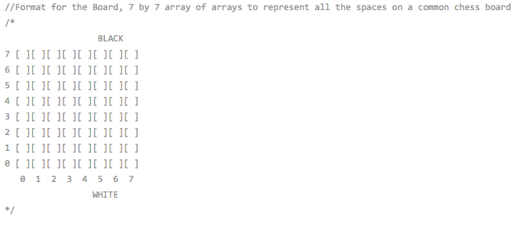
Data Structures Used
2D array for gameboard
3D array for attacks
Vector to represent moves (vector of pointers to int arrays)
Vector to represent attacks
Map to store transposition and representation tables
std::vector<int*>* getMoves();
std::vector<int*>* getAttacks();
std::vector<int*> moves;
std::vector<int*> attacks;

Slide 4
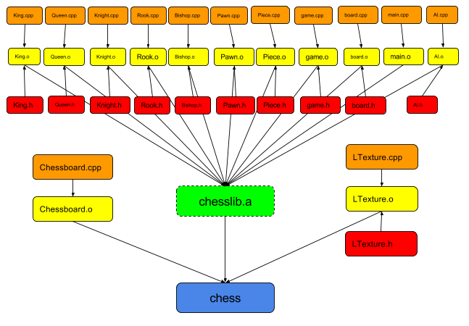
Makefile Dependencies - Inheritance

Slide 5
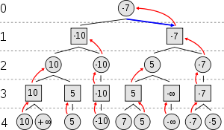
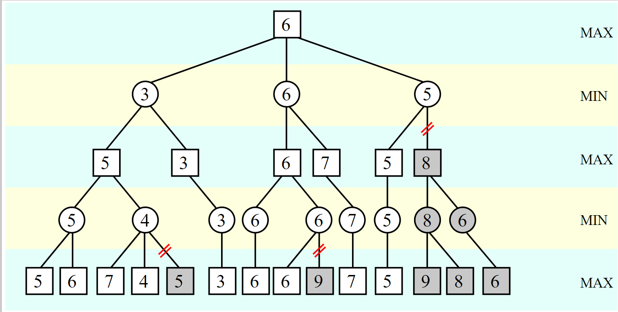
AI Minimax Tree
Recursive
Every board state has a value
Seeks to minimize then maximize values
Alpha/Beta pruning
Aspiration Windows

